Slide 1
Project Presentation of CO-OP Project at Industry (Module-2) (22CS421)
On
The Velocity-Veracity Paradox: Execution Speed vs. User Trust in Agentic AI
Abhavya Manchanda (2210990024)
Tanisha (2210990892)
Bhavkirat Singh (2210991439)
Supervised By
Dr. Gifty Gupta
Assistant Professor, CSE
Department of Computer Science and Engineering,
Chitkara University, Punjab

Slide 2
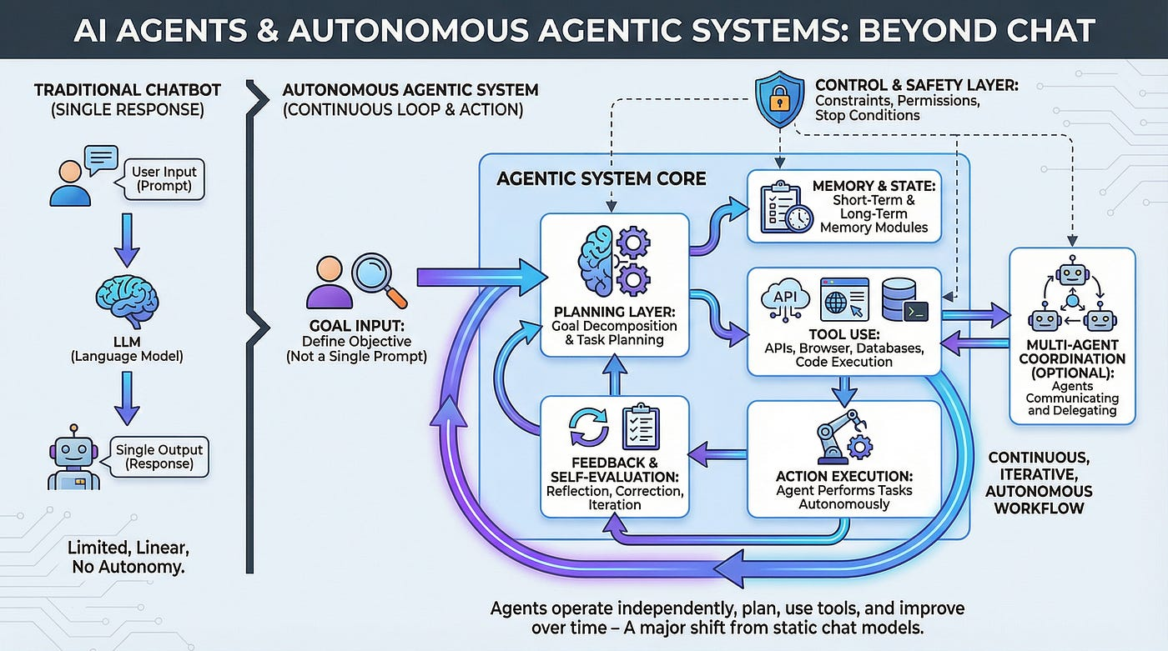
Introduction
Transitioning from reactive LLMs to Agentic AI introduces autonomous goal-setting and multi-step reasoning. However, machine speeds often outpace human verification capacity, creating an organizational absorption gap.
In high-stakes environments, such as financial diagnostics, opacity triggers betrayal aversion, where the cost of AI error increases with the perceived intelligence of the system.
2

Slide 3




Methodology
SEM Analysis
Behavioral Data
Case Study
Structural Equation Modeling on several university students measuring PEOU, PU, and Trust.
Validation across 1,000 AI-human interaction records quantifying accuracy and verification burden.
Analysis of an autonomous portfolio management system focusing on intermediate reasoning steps.

Slide 4
Tools and Technologies
Category | Tool / Technology | Application
Analysis | SmartPLS 4 | Path analysis and PLS-SEM modeling.
Data Collection | 7-point Likert Scale | Measuring PEOU, PU, and Trust constructs.
Validation | OLS Regression | Quantifying trust-accuracy-transparency dynamics.
Environment | Financial Simulation | Testing HVA vs. CVA agent performance.

Slide 5
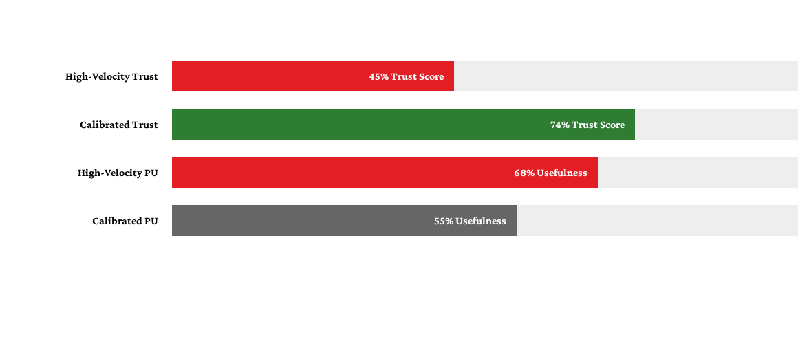
Major Findings: HVA vs. CVA

Slide 6
Conclusion and Future Scope
Calibrated Velocity: Designing AI to match human cognitive capacity through adaptive verbosity and progressive disclosure.
Cognitive Exoskeleton: Moving from black-box automation to verifiable architectural alignment.
Future Research: Longitudinal studies and physiological measures to quantify psychological costs.

Slide 7
Thank You
7

